Slide 1
I/7. Using lists
Data Analyst Intermediate – PYTHON-based Data Analysis, Data Cleaning, Data Visualization & Predictions
Data Analyst Intermediate
Trainer: Szabolcs Jobbagy

Slide 2


Creating Lists
We can store data in 1-dimensional Lists, which makes it easier to work with them
List elements/items: separated by commas, inside square brackets -> […, …, …]
len(list): the count of elements/items in the List (length)
Items in a List can have duplicates, items are changeable, and the items are ordered (they have position/index)
The index starts from 0
names = ['Jack', 'Jill', 'Robert', 'Susan'] # length of list (count of items) len(names)
# 1st item of the list names[0]
INDEX: 0 1 2 3

Slide 3
Adding, modifying, deleting List items
list.append(…): add a new element to the end of the List
list.insert(index, …): insert a new element at the given position
list.remove(…): delete an element from the List
list.clear(): delete ALL elements from the List
names = ['Jack', 'Jill', 'Robert', 'Susan'] # add a new item to the end of the list names.append('Peter')
names = ['Jack', 'Jill', 'Robert', 'Susan'] # insert a new item to a specific position of the list names.insert(1, 'Peter')
names = ['Jack', 'Jill', 'Robert', 'Susan'] # remove item from list names.remove('Jill')
names = ['Jack', 'Jill', 'Robert', 'Susan'] # remove all items from list names.clear()
names1 = ['Jack', 'Jill', 'Robert', 'Susan'] names2 = ['Peter', 'Eve'] # concatenate lists names3 = names1 + names2

Slide 4
Looping through List elements
for …variable… in list: do an action on each element in the List
for i in range( len(list) ): the same, but with looping through the index
names = ['Jack', 'Jill', 'Robert', 'Susan'] # loop through list items for name in names: print(name)
names = ['Jack', 'Jill', 'Robert', 'Susan'] # loop through list items for i in range( len(names) ): print(names[i])

Slide 5
Specific elements in a List
list[index]: The element in the List at the given position (index starts from 0)
with IF we can check if a value is in the List
INDEX: 0 1 2 3
names = ['Jack', 'Jill', 'Robert', 'Susan'] # first item of list names[0]
names = ['Jack', 'Jill', 'Robert', 'Susan'] # last item of list names[-1]
names = ['Jack', 'Jill', 'Robert', 'Susan'] a = 'Jill' if a in names: print('In the list') else: print('Not in the list')

Slide 6

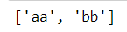

Splitting texts to List
string.split(separator): splitting text along a given separator (the result is a List)
If there is no separator, it will be a SPACE
We can refer to any split piece by its index, e.g. [0]
a = '10/March/2020' a.split('/')
a = ' aa bb ' a.split() # it will remove the empty items
a = 'Jill Susan Smith' # first item of split pieces' list a.split()[0]

Slide 7


Concatenating texts from a List
separator.join(list): concatenates items with a given separator
Since "join" has only 1 parameter, we use a List
We can trim texts by splitting and joining them, it will remove the extra spaces between words as well
names = ['Jack', 'Jill', 'Robert', 'Susan'] '-'.join(names)
# full trim: remove all extra spaces from text a = ' aa bb ' ' '.join(a.split())

Slide 8


Removing non-numeric items from List
pd.to_numeric(list, errors = 'coerce'): convert list items to numeric
errors = 'coerce': it will not show error at non-numeric items, and they will be NaN
Remove NaN items: Check if the item is equal to itself. If it is not, then it's a NaN value.
Shorthand to do FOR and IF together:
[ x for x in list if x == …… ]
import pandas as pd itemlist = [1, 2, 'Jack', 4] itemlist = list( pd.to_numeric(itemlist, errors = 'coerce') ) itemlist
# if list item is not equal to itself, it's NaN print(itemlist[1] == itemlist[1]) print(itemlist[2] == itemlist[2])
# remove NaN items from list (reduce list to items which are not NaN) itemlist = [ x for x in itemlist if x == x ] itemlist

Slide 9
Finding the difference between Lists
If we want to tell the difference between 2 Lists, i.e. which elements of the two Lists are missing from the other list, we can create a function for it
# define function: which elements of the lists are missing from the other list def listdiff(list1, list2): difference = [i for i in list1 + list2 if i not in list1 or i not in list2] return difference
names1 = ['Jack', 'Jill', 'Robert', 'Susan'] names2 = ['Jack', 'Joan', 'Peter', 'Susan'] differencelist = listdiff(names1, names2) differencelist

Slide 10

Deleting variables, Lists, etc. from memory
del ……: delete a variable, List, List-item or dataframe from memory
e.g. during testing we don't need to restart the kernel (the "programming process"), which makes all variables empty
or if the value(s) should be deleted for further calculations
# delete dataframe del df
a = 20 # delete variable del a a
names = ['Jack', 'Jill', 'Robert', 'Susan'] # delete list item del names[0] names

Slide 11
I/8. Data Analysis, Data Transformation AND Data Cleaning with Pandas II.
Data Analyst Intermediate – PYTHON-based Data Analysis, Data Cleaning, Data Visualization & Predictions
Data Analyst Intermediate
Trainer: Szabolcs Jobbagy

Slide 12

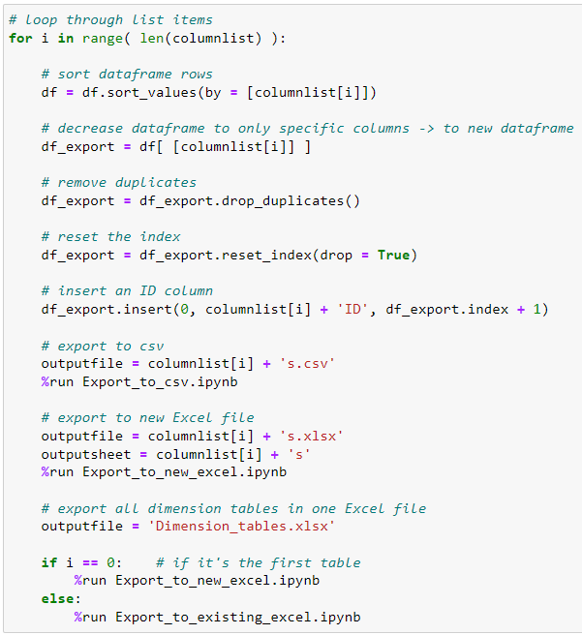

Simplifying our code with Lists
Organize exporting to Excel tasks to two separate programs: "Export_to_new_excel", "Export_to_existing_excel"
Copy "Create_dimension_tables" program: "Create_dimension_tables_v2"
We need to do the same tasks for 3 tables ("Products", "Customers", "Salespersons"), but with using Lists, we should only add tasks once
Save "Create_dimension_tables_v2", then in "Clean_multiple_files" change the program name as well
Delete files from "All periods" folder and run "Clean_multiple_files" again
columnlist = ['Product', 'Customer', 'Salesperson']

Slide 13

Reading data from Excel files into a Dataframe
Start new notebook
pd.read_excel: read data from Excel
sheet_name: name of the Excel sheet
usecols: which columns to import
It reads the sheet until the bottom of the table with the MOST ROWS
paramfolderpath = r'D:\Trainings\Cubix\Python_DA' paramfile = 'Parameters.xlsx' paramfile_sheet = 'Parameter tables'
# read Excel data into dataframe df_param = pd.read_excel(paramfolderpath + '\\' + paramfile, sheet_name = paramfile_sheet, usecols = 'A:B')

Slide 14
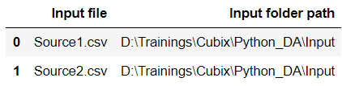
Delete rows or columns with empty values
df.dropna(): drop rows where ANY column's value is empty
df.dropna(subset = [columnnamelist]): drop rows where ANY of the listed columns' value is empty
df.dropna(how = 'all'): drop rows where ALL column values are empty
df.dropna(axis = 1): drop columns where ANY row's value is empty
df.dropna(subset = [rowindexlist], axis = 1): drop columns where ANY of the listed rows' value is empty
df.dropna(how = 'all', axis = 1): drop columns where ALL row values are empty
# drop rows where ANY of the listed columns' value is empty df_param = df_param.dropna(subset = ['Input file'])

Slide 15
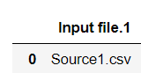
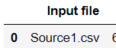
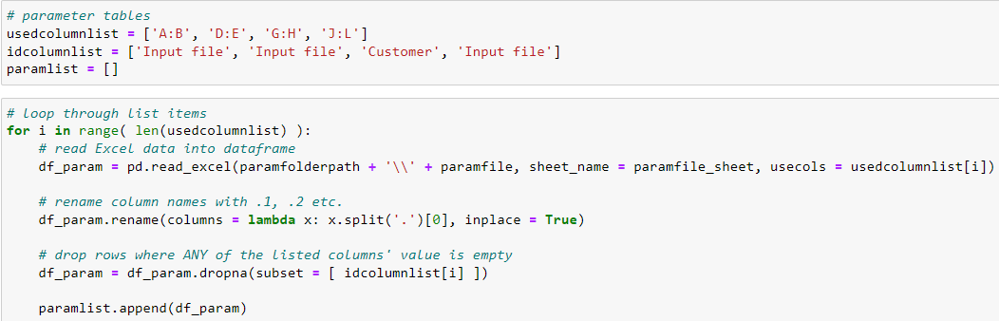
Handling columns with the same header
When reading the 2nd (Products) parameter table, we will see that the "Input file" header was renamed to "Input file.1", as there was already an "Input file" column header before (and in the Headers table there will be an "Input file.2" as well)
df.rename: rename column headers or row index labels
columns = …formula…: we can add the renaming formula, e.g. with a lambda function
inplace = True: do not create a new dataframe, do it in place
Read all 4 parameter tables from Excel by using Lists
# rename column names with .1, .2 etc. df_param.rename(columns = lambda x: x.split('.')[0], inplace = True)

Slide 16

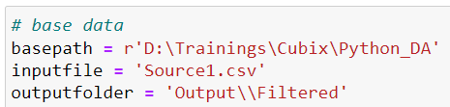
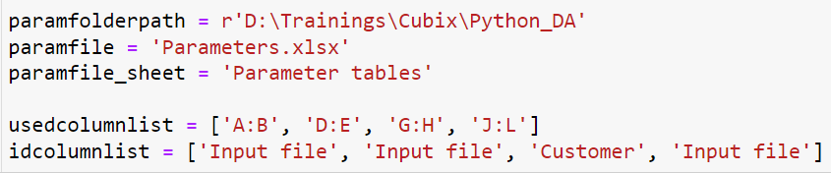
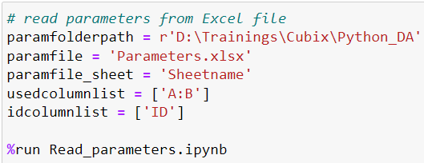
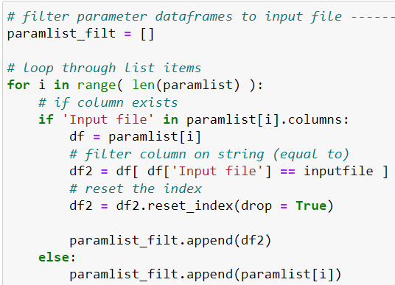
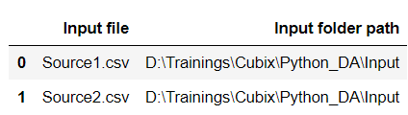

Filtering Dataframe columns based on text
Copy "Clean_multiple_files" notebook: Filter_multiple_files_by_parameters
Change base data, create output folder
Move param variables out of "Read_parameters" program (as it should be reusable in many different projects) to this main file
Call the "Read_parameters" external program by %run
column.str.contains(substring): filter column on substring
Filter all parameter df's in "paramlist" to inputfile (if "Input file" column exists), to a new List: "paramlist_filt" (parameter list filtered to input file)
df = paramlist[0] # folders
# filter column on substring (contains) -> to new dataframe df2 = df[ df['Input file'].str.contains(inputfile) ]
# filter column on string (equal to) -> to new dataframe df2 = df[ df['Input file'] == inputfile ]

Slide 17
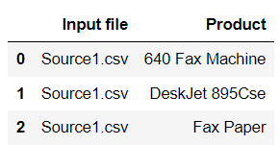

Adding column or row values to List
column.tolist(): add values of the column to a List
list(df.columns): add column headers to List
list(row/column slice): add row/column values to List
list(row/column slice).index(value): finding the position of a value in a row/column (like "MATCH" formula in Excel)
df = paramlist_filt[1] # products
# add column values to list productlist = df['Product'].tolist()
# add column headers to list list(df.columns)
list(df.loc[0]) # add row values to list
list(df.loc[ : , 'Product']) # add column values to list
# position of a value in a row list(df.loc[0]).index('640 Fax Machine')
# position of a value in a column list(df.loc[ : , 'Product']).index('640 Fax Machine')

Slide 18
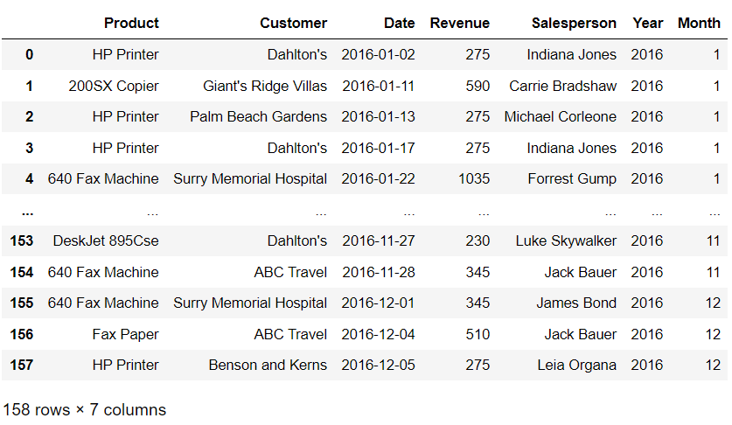
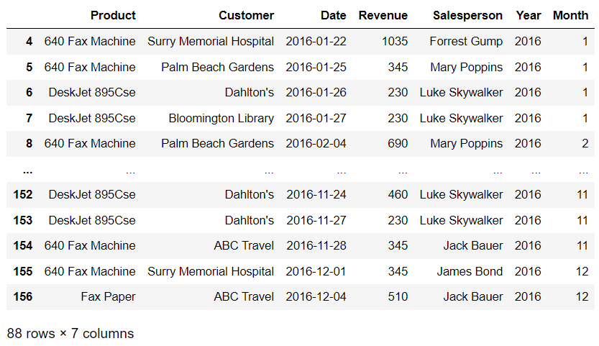
Filtering Dataframe columns with a List
column.isin(list): values of the column which are in the List
column.unique(): unique values of column (no duplicates)
# filter column to values which are in the list df = df[ df['Product'].isin(productlist) ]
# add unique column values to list, without duplicates productlist_unique = list(df['Product'].unique())

Slide 19
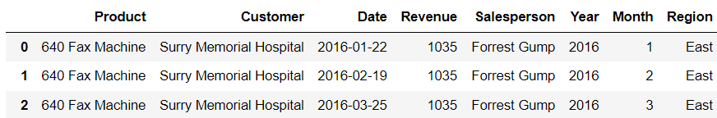

Merging two Dataframes to look up values
pd.merge(df1, df2): merging 2 dataframes based on their matching columns (like "VLOOKUP" formula in Excel, looking up the related values from the other table)
on: on which column to join (if not identical, we can add them separately: left_on, right_on)
how: type of the join ('left', 'right', 'outer', 'inner', 'cross')
Export the final dataframe to CSV file
dfp_regions = paramlist_filt[2]
# merge 2 dataframes df = pd.merge(df, dfp_regions, on = 'Customer', how = 'inner')

Slide 20

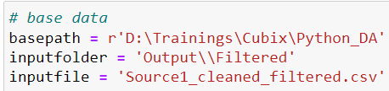
Reading CSV files with special parameters
Start new notebook
Add base data
pd.read_csv: Read CSV file
Special parameters:
nrows: how many rows to read -> nrows = 100
usecols: which columns to read, from List -> usecols = columnlist
converters: any columns can be modified, e.g. converting into text if there are numeric codes starting with zero, or replacing substrings -> converters = { 'column name': lambda x: str(x) } converters = { 'column name': lambda x: x.replace(' ', '_') }
columnlist = ['Product', 'Customer', 'Date', 'Revenue'] rows_to_read = 10 converter_formula = { 'Date': lambda x: x.replace('-', '') } # read data from csv file into a dataframe df = pd.read_csv(basepath + '\\' + inputfolder + '\\' + inputfile, sep = ';', encoding = 'utf-8', usecols = columnlist, nrows = rows_to_read, converters = converter_formula )

Slide 21

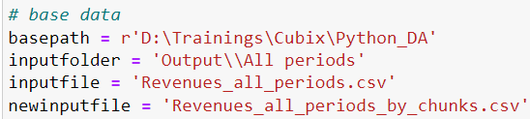
Reading large size CSV files (millions of rows)
Start new notebook
When reading large CSV files with many millions of rows, the memory may fill up and the computer freezes
Therefore, we can read the data in smaller "chunks" (e.g. 5 million rows each)
chunksize: number of rows per chunk, iterator = True: to loop through the chunks
The portions can be pre-filtered, then saved in a new, smaller CSV file
columnlist = ['Product', 'Customer', 'Date', 'Revenue'] customerlist = ['ABC Travel', 'Artec'] inputfilepath = basepath + '\\' + inputfolder + '\\' + inputfile newinputfilepath = basepath + '\\' + inputfolder + '\\' + newinputfile
# read csv in chunks chunkrows = 20 chunks = pd.read_csv(inputfilepath, sep = ';', encoding = 'utf-8', usecols = columnlist, chunksize = chunkrows, iterator = True) i = 0 for df in chunks: i += 1 # filter column to values which are in the list df = df[ df['Customer'].isin(customerlist) ] # export data in a new, smaller CSV file if i == 1: df.to_csv(newinputfilepath, index = False, encoding = 'utf-8', sep = ';') else: # exporting to csv in append mode, withour header row df.to_csv(newinputfilepath, mode = 'a', header = False, index = False, encoding = 'utf-8', sep = ';')

